Slide 1

Final Presentation: surrogate modeling of drainage networks under coastal flooding
Mohammad Movahhed
AI for Urban Water Networks
Instructor: Dr. Fan

Slide 2
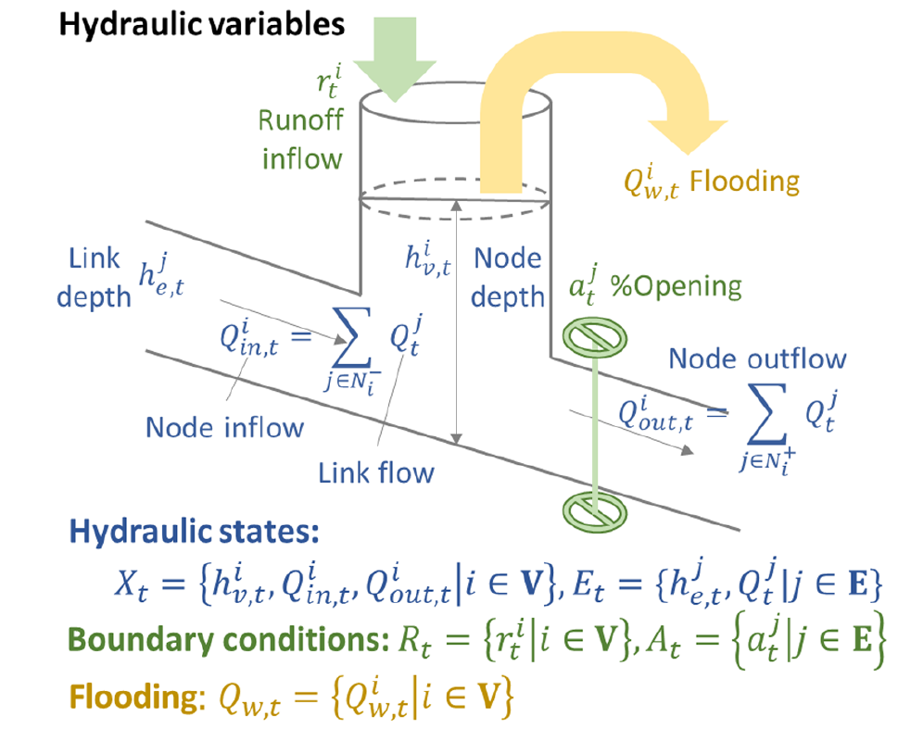
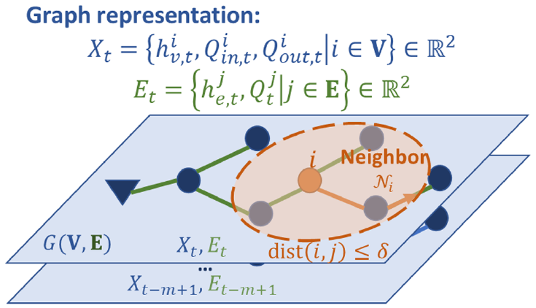
Recap
Accuracy
Physics-based modeling
Efficiency
Surrogate modeling
Notes:
SMs are mathematical approximations employed to emulate a system’s behavior by learning the relationships between input parameters and output responses directly from precomputed simulations.

Slide 3
Required Data
Storm surge
Bathtub model
Inundation time series
Topography
SWMM model
Outfall discharge
Drainage network
New Storm
Surrogate model
Estimated discharge

Slide 4
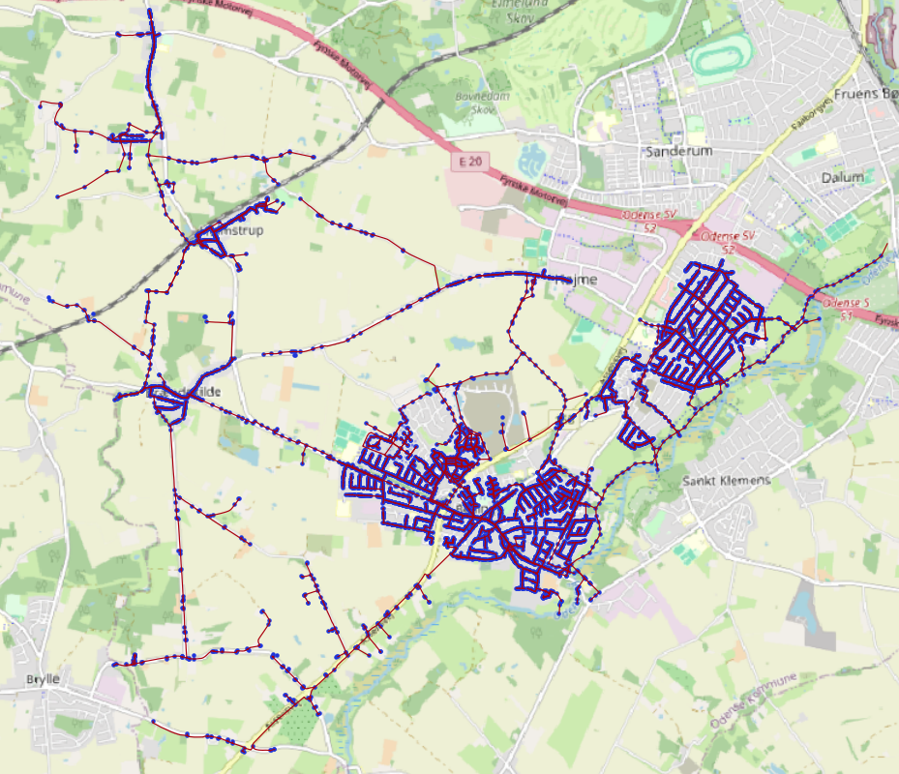
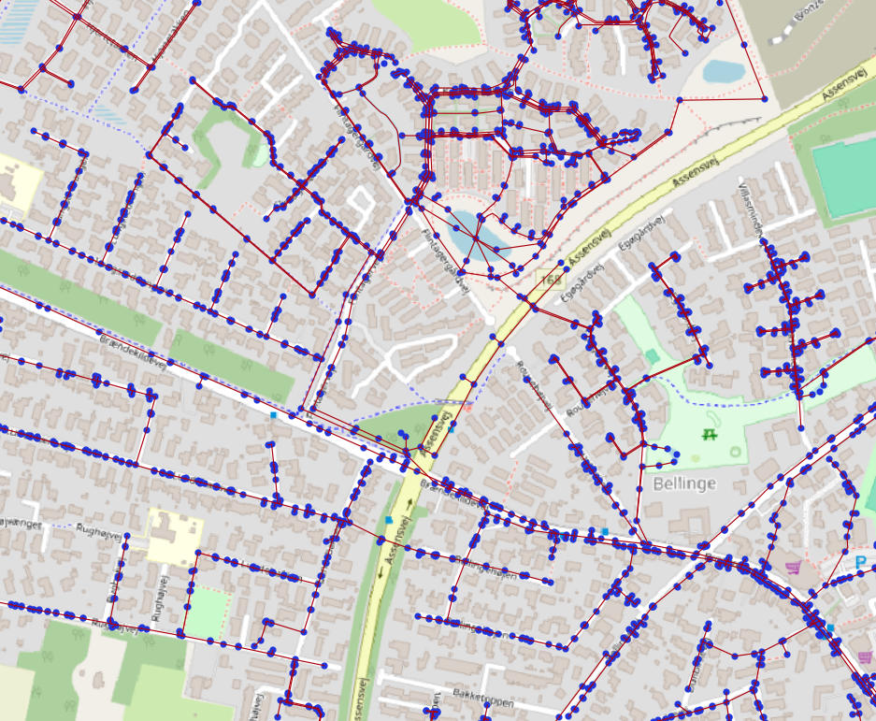
Benchmark Case Study
Bellinge, Denmark
Consists of combined and separate systems
Over 10,000 nodes

Slide 5
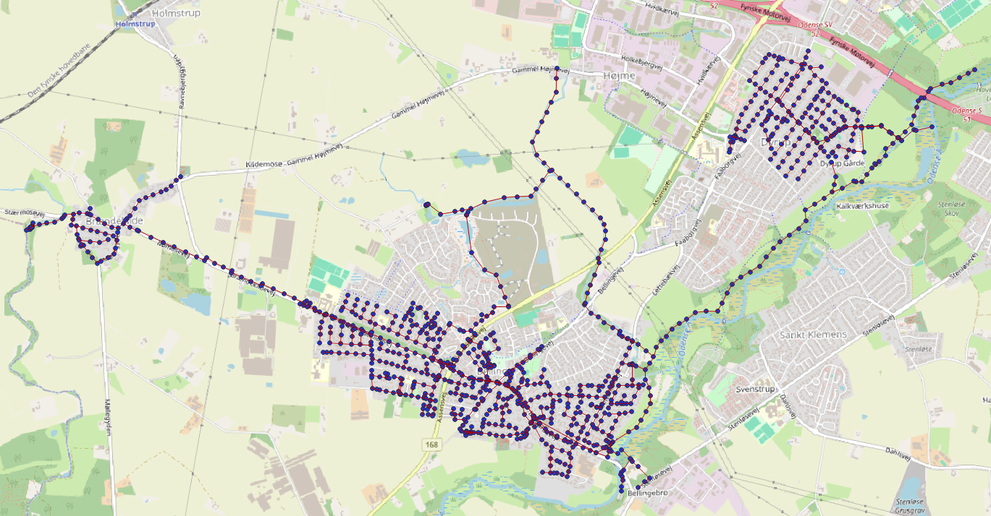
Benchmark Case Study
Combined network
1020 Nodes
1026 Edges
Notes:
Nodes are outfalls, manholes, and storages
Links are conduits, pumps, and orifices

Slide 6
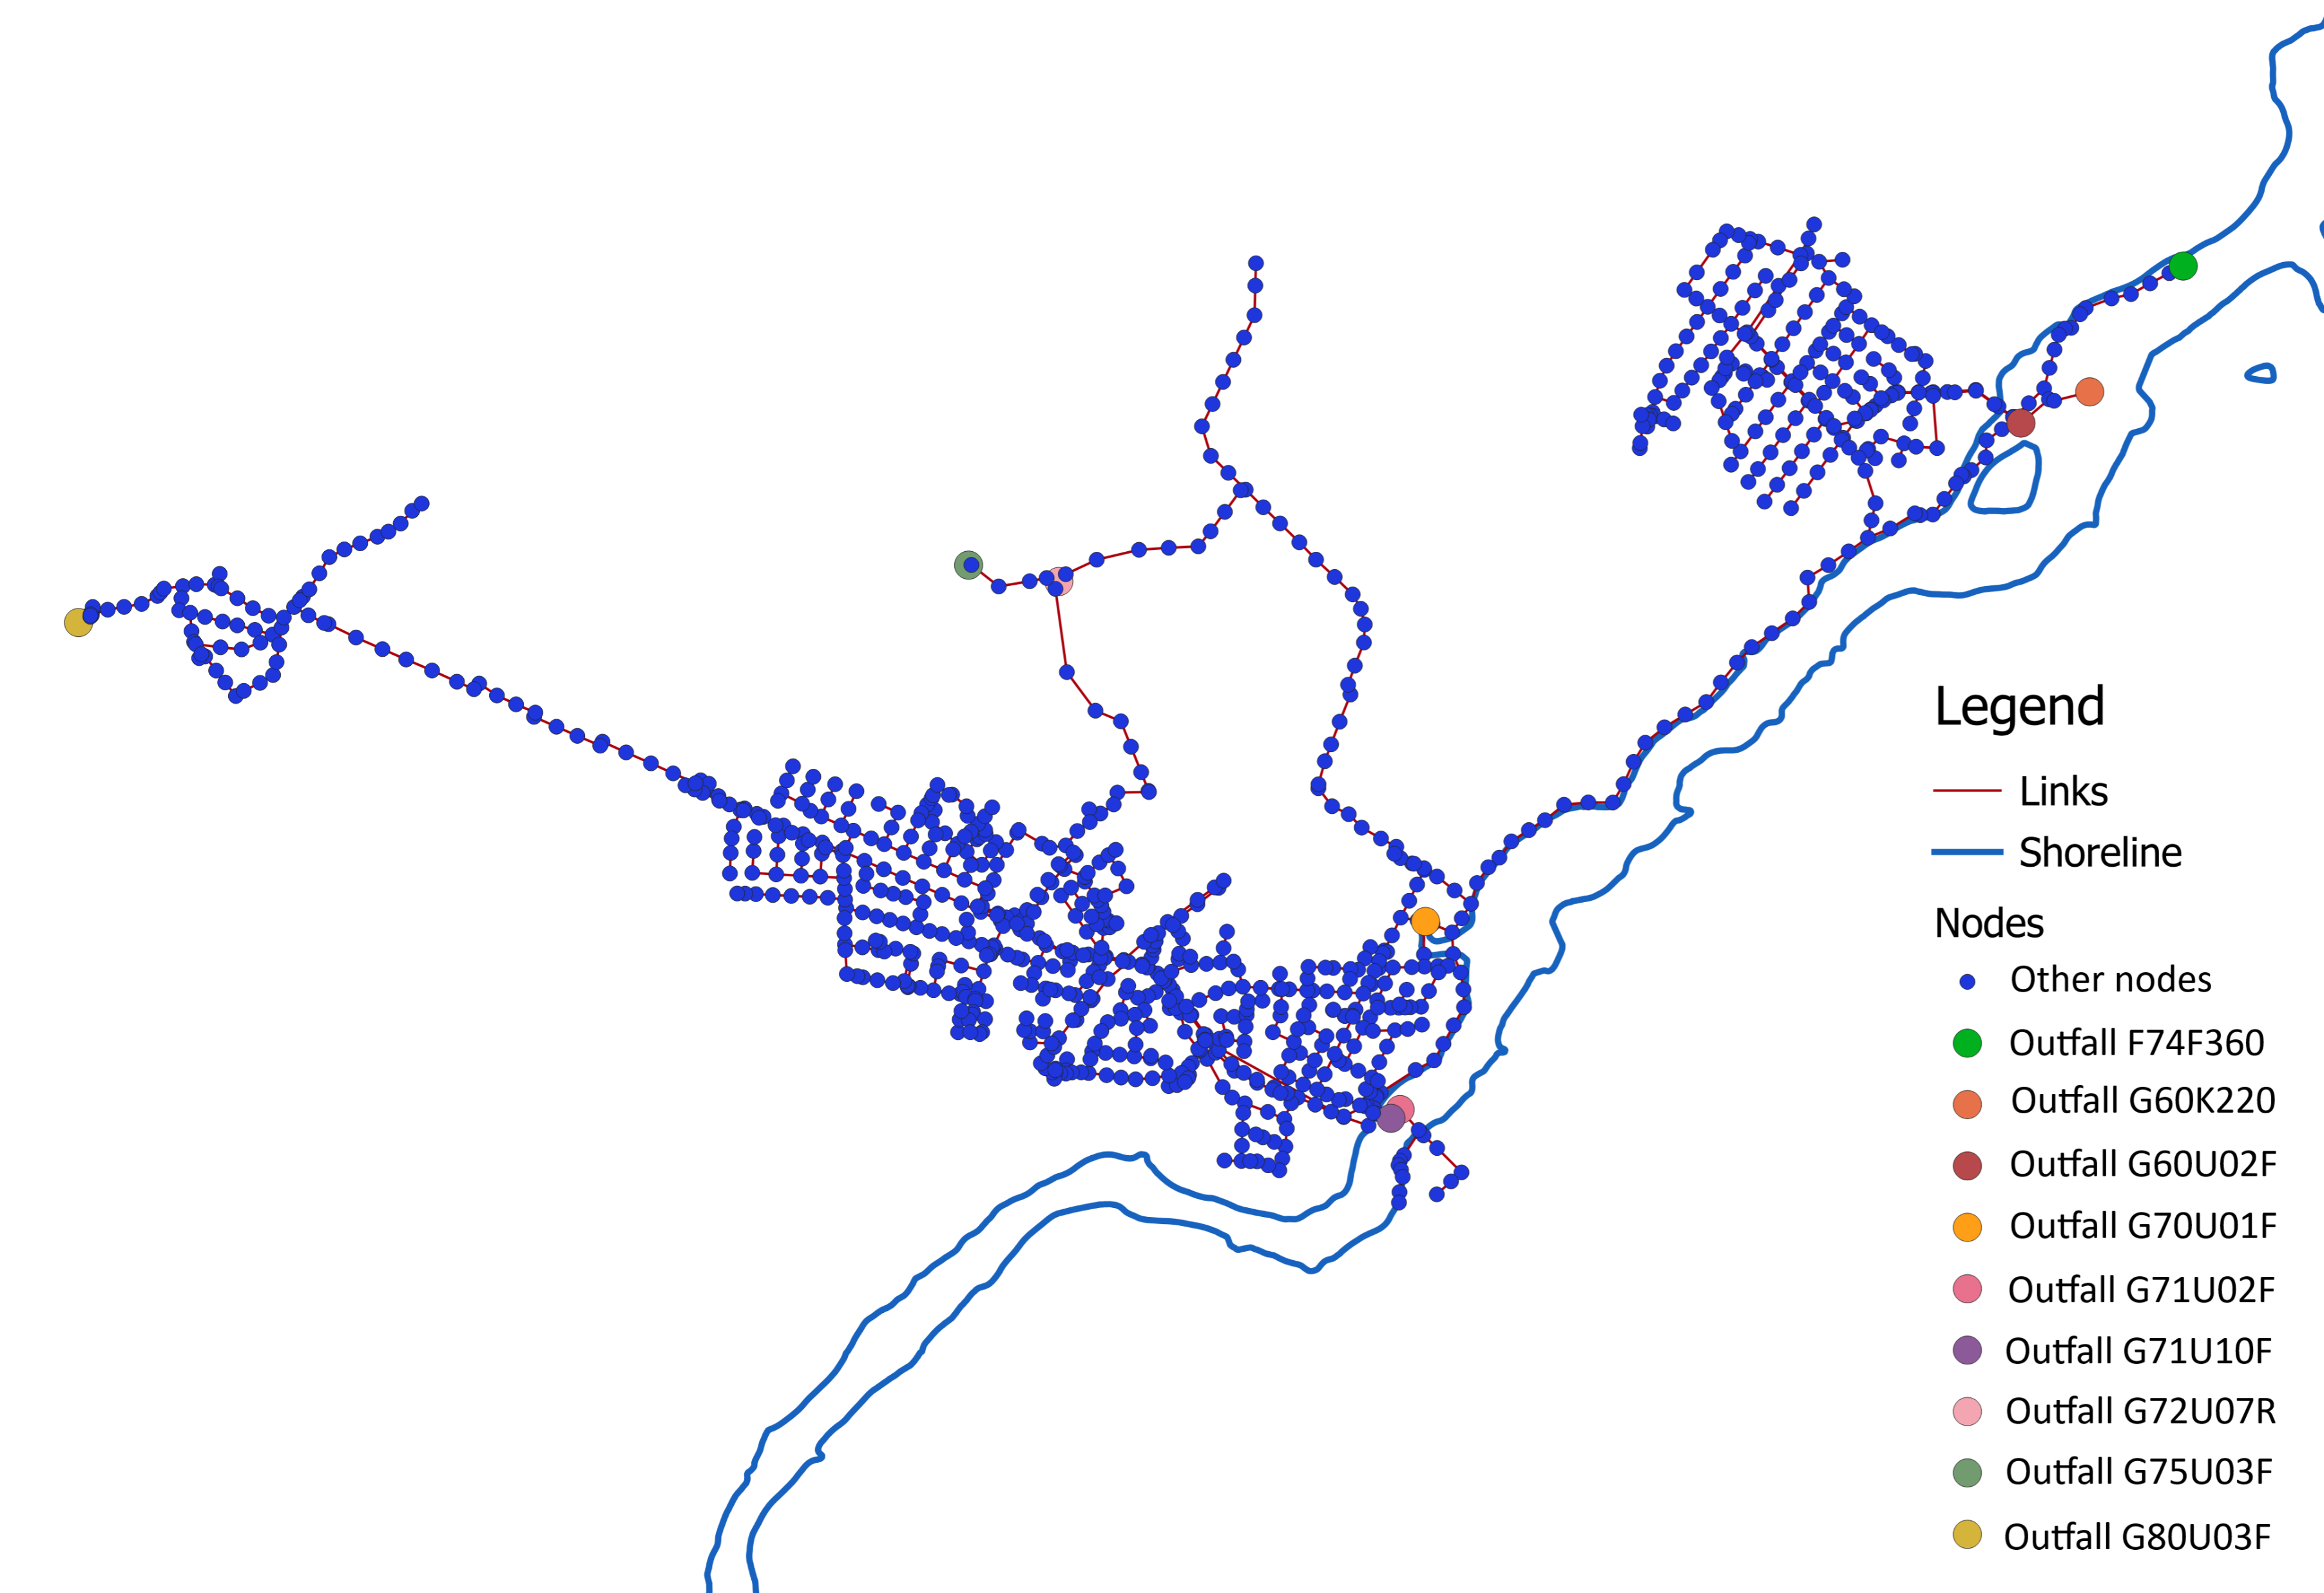
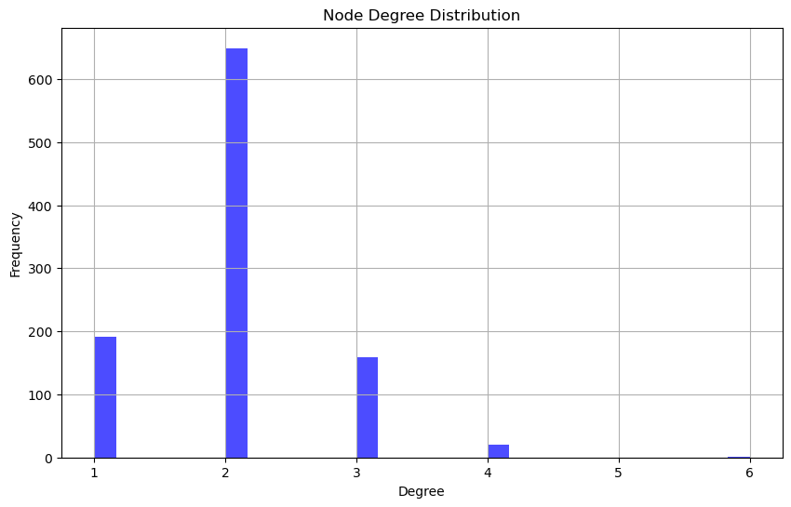
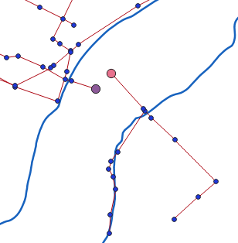
Benchmark Case Study
Average node degree: 2.01
Average betweenness centrality: 0.0025
Assortativity coefficient: 0.0116
Triadic closure: 0.023
Network diameter cannot be defined
Notes:
Average node degree: 2.01
Average betweenness centrality: 0.0025
Degree assortativity coefficient: 0.0116 (no patterns)
Triadic closure: 0.023 (no closed triads)
Network diameter cannot be defined

Slide 7
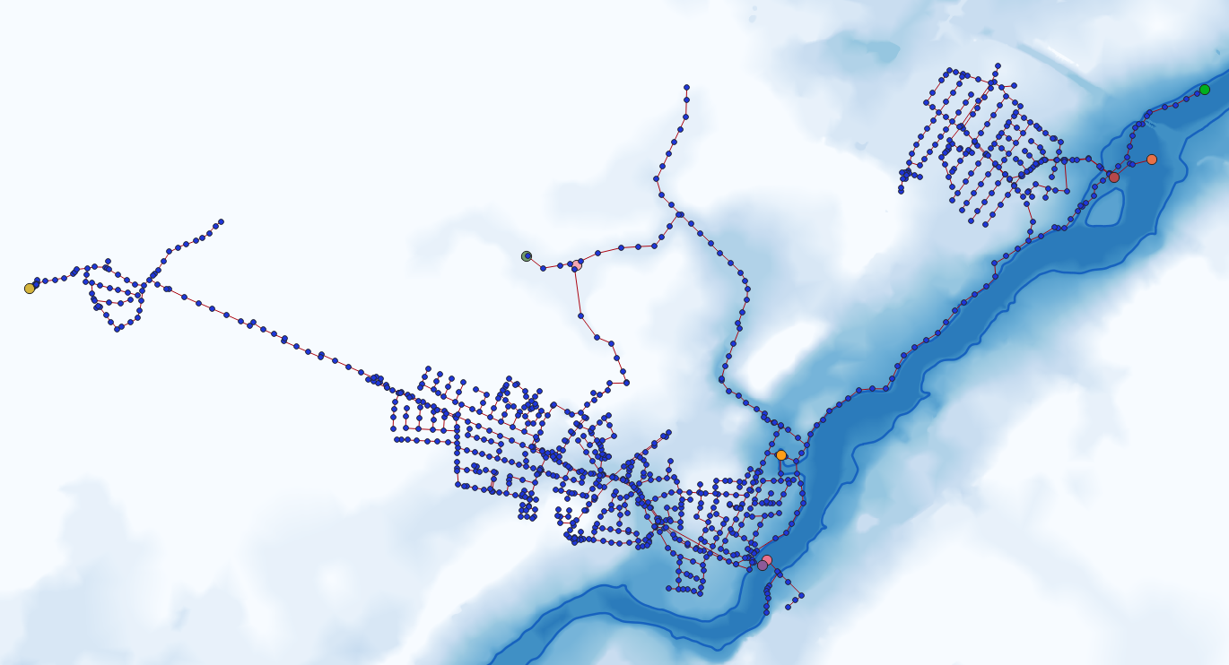
Flood Scenarios
74 storm surge scenarios with 15 min interval were gathered from the coastal hazard system data base.
Notes:
River is assumed to be the coastline.

Slide 8
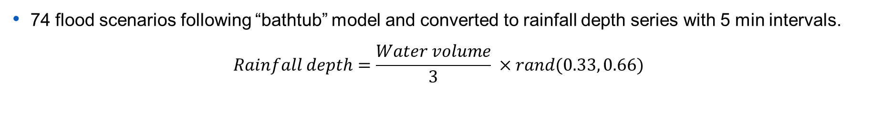
Conversion to Rainfall Scenarios
74 flood scenarios following “bathtub” model and converted to rainfall depth series with 5 min intervals.
$$Rainfall depth=\frac{Water volume}{3} ×rand(0.33, 0.66)$$

Slide 9
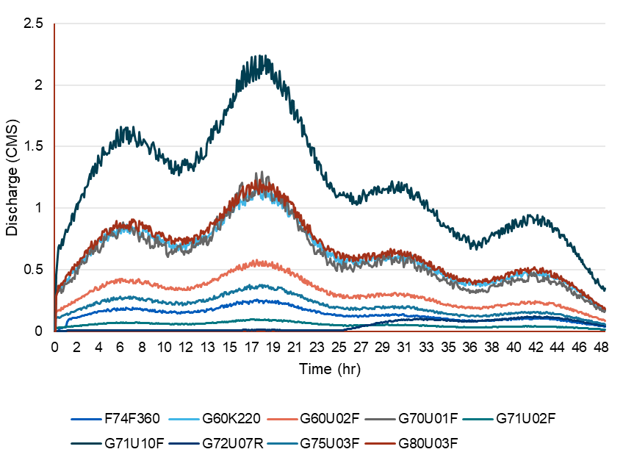
Drainage simulations
Discharge time series at 9 outfalls of the network were obtained from SWMM simulations for all 74 scenarios.
SWMM model
Notes:
Outfall discharges are just shown for one scenario

Slide 10
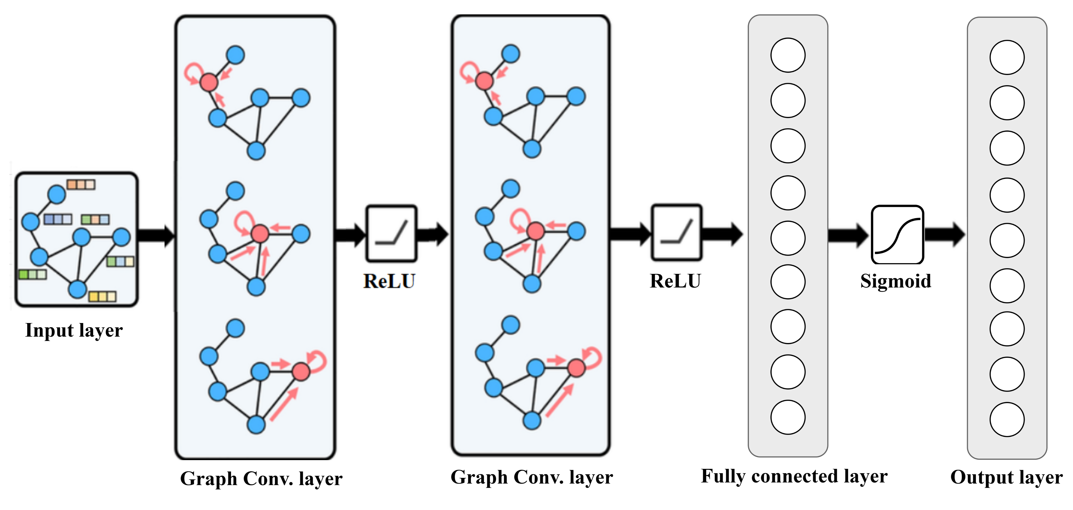
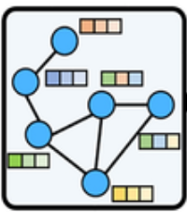
GCN Structure
Three graph convolutional layers followed by ReLU
GCN layers: 48 neurons
One fully connected layer followed by sigmoid
F74F360
G60K220
G60U02F
G70U01F
G71U02F
G71U10F
G72U07R
G75U03F
G80U03F

Slide 11
GCN Informations
Node features as Input
Static | Dynamic
Elevation | Rainfall Past 24 timesteps (2 hours)
Depth | Time encoding Normalized timestep
X coordinate
Y coordinate
Distance to shoreline
SUM = | 30 features
Training dataset: 54 scenarios
Testing dataset: 20 scenarios
Output: Discharge at 9 Outfalls for the current time step

Slide 12
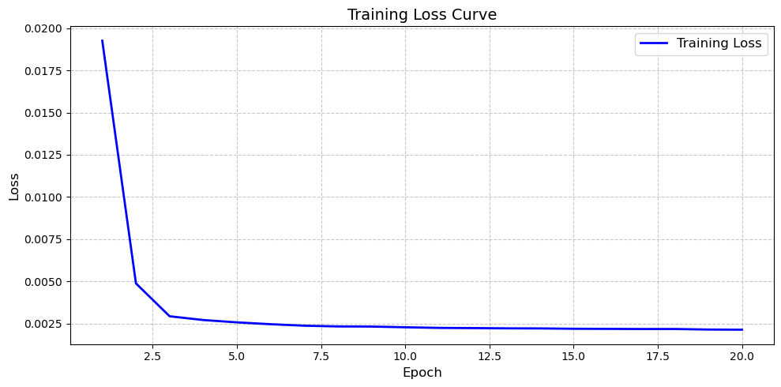
Model Training
Loss function: Mean Square Error (MSE)
(Average loss of all 9 outfalls)
Optimizer: Adam optimizer with learning rate of 0.0001

Slide 13
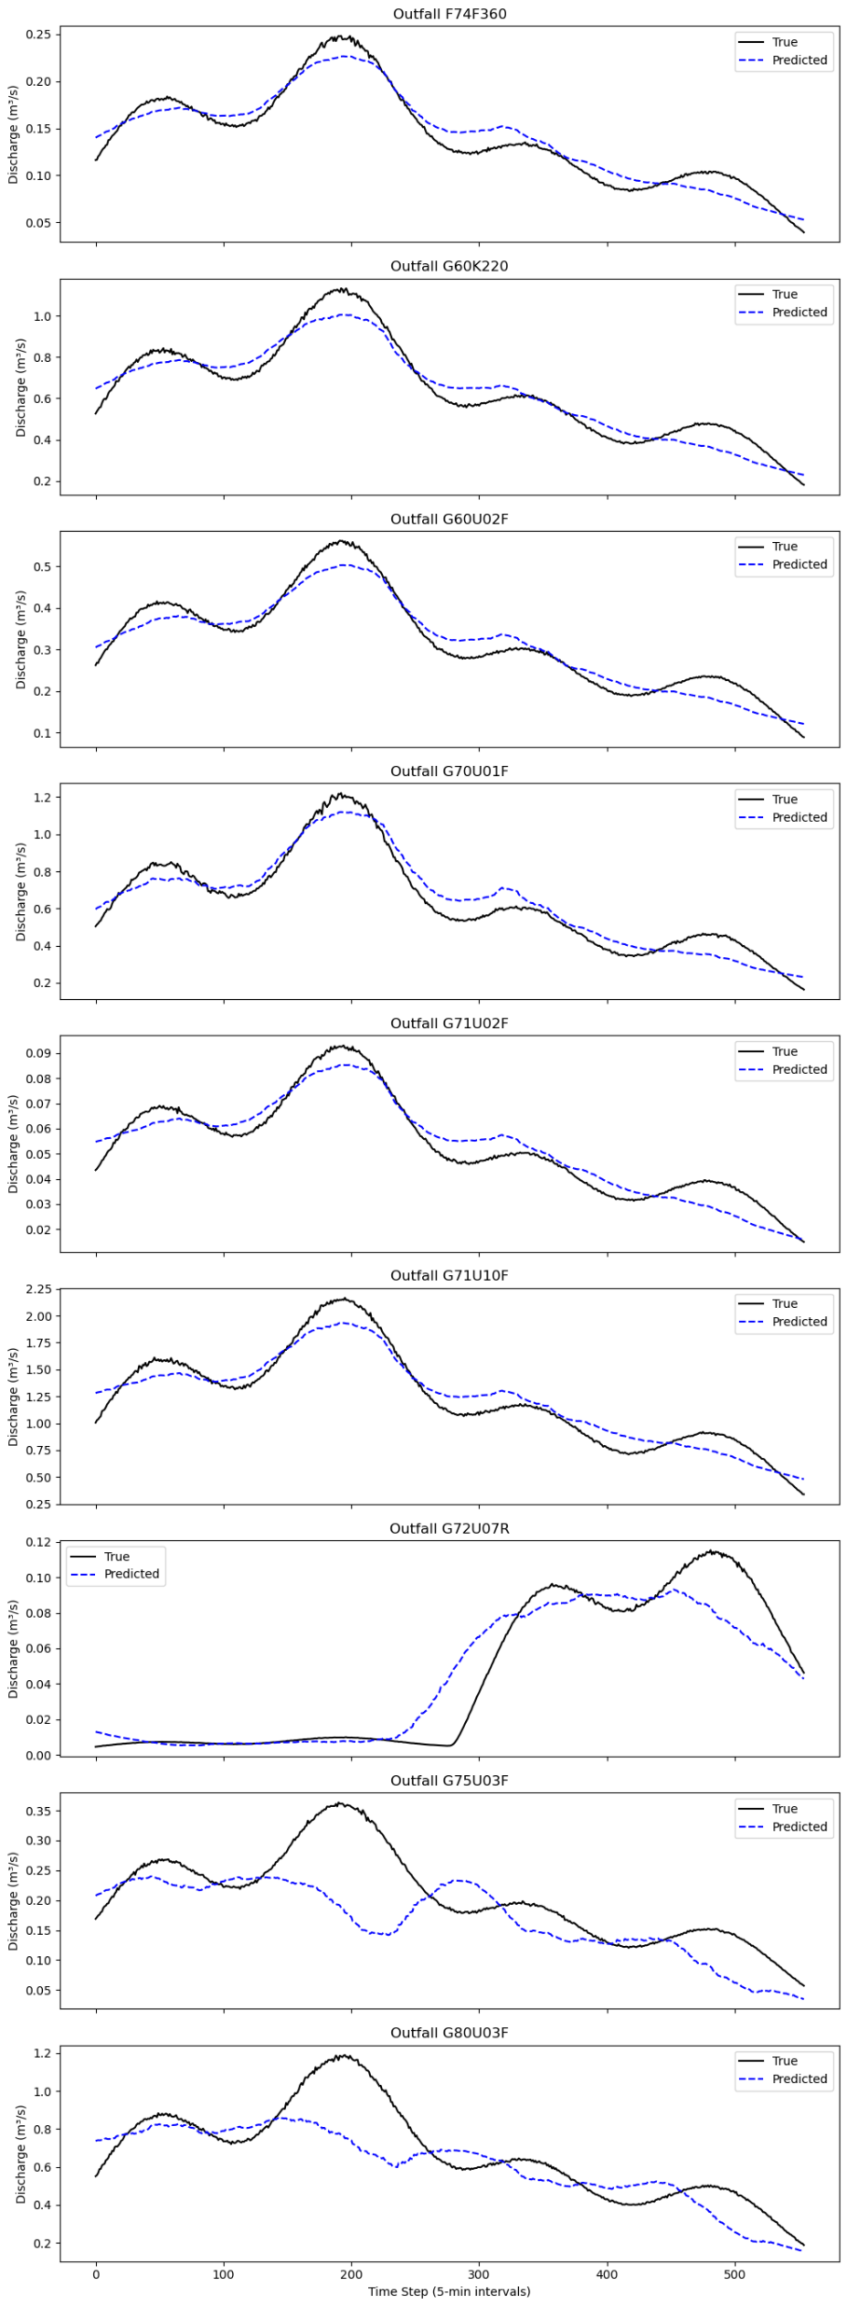
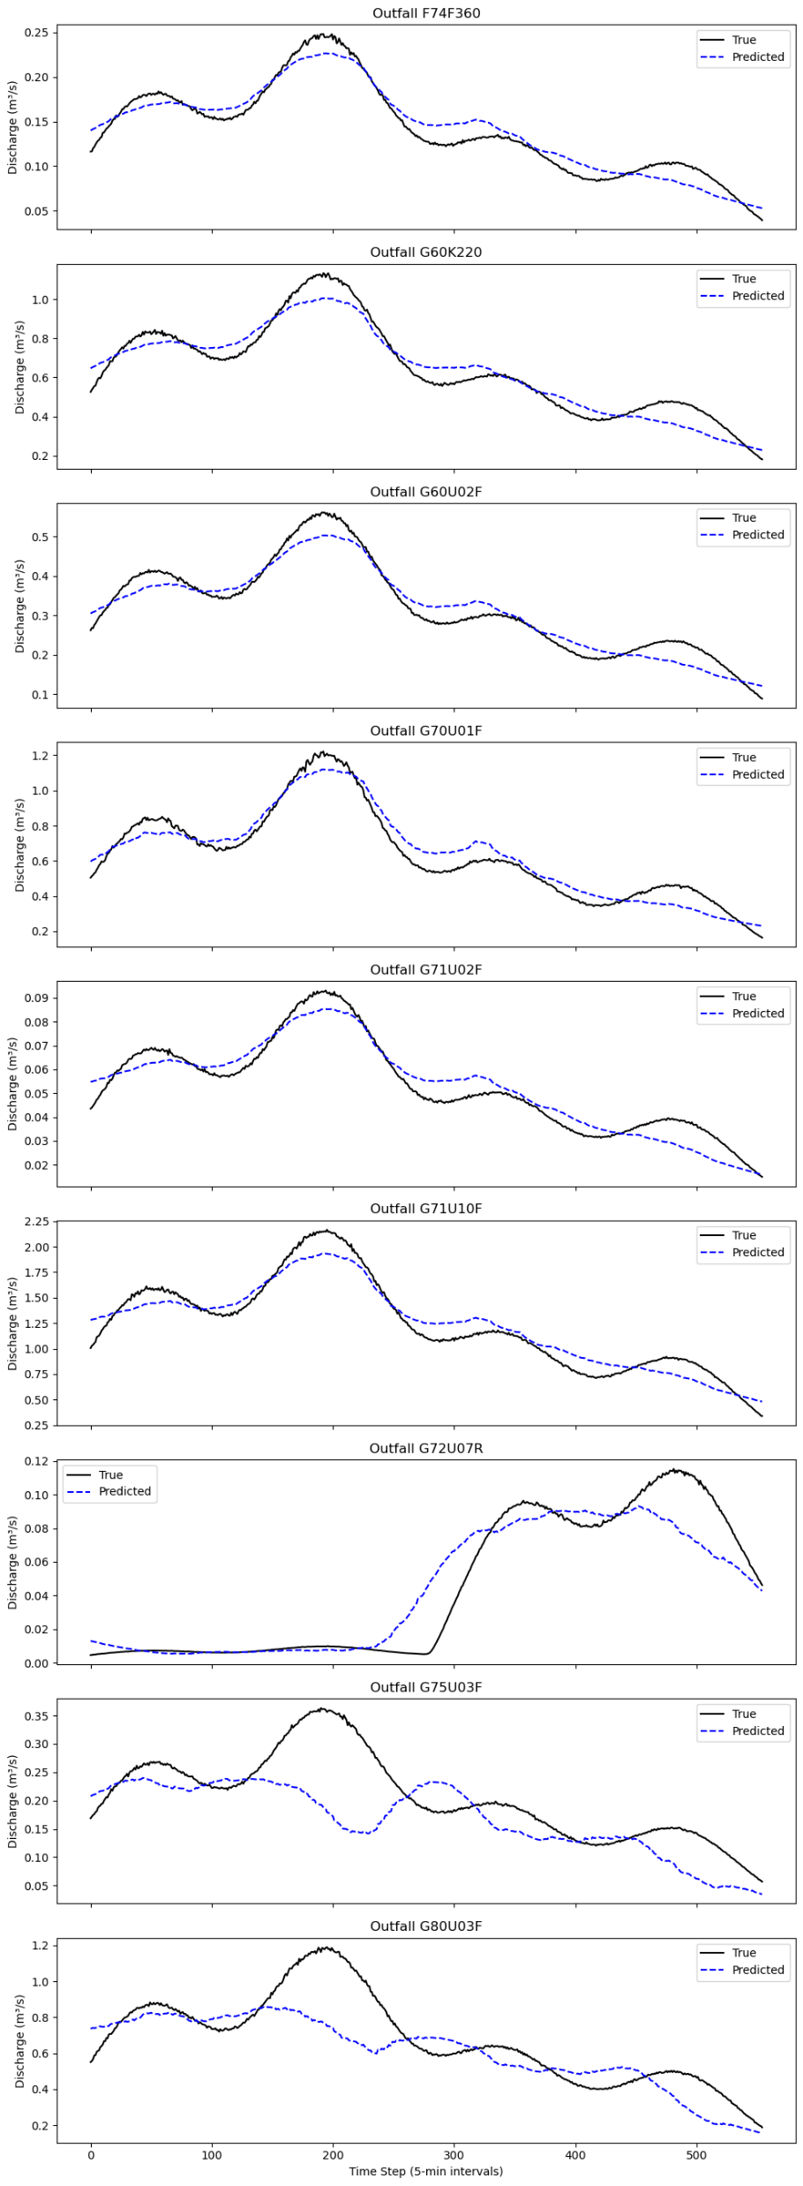
Model Testing
F74F360 MSE = 0.003216
G60K220 MSE = 0.003539
G60U02F MSE = 0.003308
G70U01F MSE = 0.003398
G71U02F MSE = 0.004121
G71U10F MSE = 0.003518
G72U07R MSE = 0.019106
G75U03F MSE = 0.035731
G80U03F MSE = 0.018427

Slide 14
Conclusion
Results show that
The GCN-based surrogate model was able to provide rapid estimations with high accuracy.
Loss value converges very fast, indicating that the learning process is trivial. This might be due to poor scenario selection.
As the next step:
Select more diverse scenarios for training and testing to obtain better generalization.
Add another GCN layer to consider the relationship of neighboring nodes at a higher order
Employ a batching algorithm to improve training speed and convergence rate.
Using a higher learning rate but with reduction on plateau

Slide 15
Thank you for your attention

